Slide 1
Discrete Mathematical Chapter 1

Slide 2
Let’s get started with...

Slide 3
Discrete Mathmatics
Discrete mathematics is fundamental in algorithm design, cryptography, graph theory, logic, sets, and computability, and it is a collection of techniques and algorithms relevant to all sorts of things you often need to do when programming.
Discrete mathematics has applications to compilers, software engineering, architecture, data bases, algorithms, data structures, and operating systems.
Discrete mathematics can be applied in the following fields:

Slide 4
Graphs(collections of nodes and edges).
Examples:
How do you find the quickest way across town? How can you drive around a neighborhood to deliver papers, making sure you drive on each road exactly once?
How much water can a complicated pipeline deliver to all the homes connected to it?
What’s the bottleneck for fed-ex delivering packages all over the world?
All of the above examples can be solved with graph theory.

Slide 5
Complexity theory: given three ways of solving a problem, which one will work faster? This is harder to figure out than it sounds.
Classification Problems, where you need to classify objects and check for their membership: is it a type of duck? a dog? how many creatures are in each category? Set theory give you a way to work with this sort of question.
There’s a lot more to it, but this is some of the highlights applications of discrete mathematics

Slide 6
Logic
Why we need logic?
It is essential for mathematical reasoning
It is important for program design
It is used for designing electronic circuitry
Proposition is a declarative sentence that is either true or false (not both).
(Propositional )Logic is a system based on propositions.
We say that the truth value of a proposition is either true (T) or false (F).
Corresponds to 1 and 0 in digital circuits

Slide 7
The Statement/Proposition Game
“Elephants are bigger than mice.”
Is this a statement?
yes
Is this a proposition?
yes
What is the truth value
of the proposition?
true

Slide 8
The Statement/Proposition Game
“520 < 111”
Is this a statement?
yes
Is this a proposition?
yes
What is the truth value
of the proposition?
false

Slide 9
The Statement/Proposition Game
“y > 5”
Is this a statement?
yes
Is this a proposition?
no
Its truth value depends on the value of y, but this value is not specified.
We call this type of statement a propositional function or open sentence.

Slide 10
The Statement/Proposition Game
“Today is January 27 and 99 < 5.”
Is this a statement?
yes
Is this a proposition?
yes
What is the truth value
of the proposition?
false

Slide 11
The Statement/Proposition Game
“Please do not fall asleep.”
Is this a statement?
no
It’s a request.
Is this a proposition?
no
Only statements can be propositions.

Slide 12
The Statement/Proposition Game
“If the moon is made of cheese,
then I will be rich.”
Is this a statement?
yes
Is this a proposition?
yes
What is the truth value
of the proposition?
probably true

Slide 13
The Statement/Proposition Game
“x < y if and only if y > x.”
Is this a statement?
yes
Is this a proposition?
yes
… because its truth value does not depend on specific values of x and y.
What is the truth value
of the proposition?
true

Slide 14
Combining Propositions
As we have seen in the previous examples, one or more propositions can be combined to form a single compound proposition.
We formalize this by denoting propositions with letters such as p, q, r, s,c,.. and introducing several logical operators or logical connectives.

Slide 15
Logical Operators (Connectives)
We will examine the following logical operators:
Negation (NOT, ¬)
Conjunction (AND, ∧)
Disjunction (OR, ∨)
Exclusive-or (XOR, ⊕ )
Implication (if – then, → )
Biconditional (if and only if, ↔ )
Truth tables can be used to show how these operators can combine propositions to compound propositions.

Slide 16
Negation (NOT)
Unary Operator, Symbol: ¬
P | ¬ P
true (T) | false (F)
false (F) | true (T)

Slide 17
Conjunction (AND)
Binary Operator, Symbol: ∧
P | Q | P∧ Q
T | T | T
T | F | F
F | T | F
F | F | F

Slide 18
Disjunction (OR)
Binary Operator, Symbol: ∨
P | Q | P ∨ Q
T | T | T
T | F | T
F | T | T
F | F | F

Slide 19
Exclusive Or (XOR)
Binary Operator, Symbol: ⊕
P | Q | P⊕Q
T | T | F
T | F | T
F | T | T
F | F | F

Slide 20
Implication (if - then)
Binary Operator, Symbol: →
P | Q | P→Q
T | T | T
T | F | F
F | T | T
F | F | T

Slide 21
Biconditional (if and only if)
Binary Operator, Symbol: ↔
P | Q | P↔Q
T | T | T
T | F | F
F | T | F
F | F | T

Slide 22
Statements and Operators
Statements and operators can be combined in any way to form new statements.
P | Q | ¬P | ¬Q | (¬P)∨(¬Q)
T | T | F | F | F
T | F | F | T | T
F | T | T | F | T
F | F | T | T | T

Slide 23
Statements and Operations
Statements and operators can be combined in any way to form new statements.
P | Q | P∧Q | ¬(P∧Q) | (¬P)∨(¬Q)
T | T | T | F | F
T | F | F | T | T
F | T | F | T | T
F | F | F | T | T

Slide 24
Exercises
To take discrete mathematics, you must have taken calculus or a course in computer science.
When you buy a new car from Acme Motor Company, you get $2000 back in cash or a 2% car loan.
School is closed if more than 2 feet of snow falls or if the wind chill is below -100.

Slide 25
Exercises
To take discrete mathematics, you must have taken calculus or a course in computer science.
P: take discrete mathematics
Q: take calculus
R: take a course in computer science
P → Q ∨ R
Problem with proposition R
What if I want to represent “take CMSC201”?

Slide 26
Exercises
When you buy a new car from Acme Motor Company, you get $2000 back in cash or a 2% car loan.
P: buy a car from Acme Motor Company
Q: get $2000 cash back
R: get a 2% car loan
P → Q ⊕ R
Why use XOR here? – example of ambiguity of natural languages

Slide 27
Exercises
School is closed if more than 2 feet of snow falls or if the wind chill is below -100.
P: School is closed
Q: 2 feet of snow falls
R: wind chill is below -100
Q ∧ R → P
Precedence among operators:
¬, ∧, ∨, →, ↔

Slide 28
Equivalent Statements
P | Q | ¬(P∧Q) | (¬P)∨(¬Q) | ¬(P∧Q)↔(¬P)∨(¬Q)
T | T | F | F | T
T | F | T | T | T
F | T | T | T | T
F | F | T | T | T
The statements ¬(P∧Q) and (¬P) ∨ (¬Q) are logically equivalent, since they have the same truth table, or put it in another way, ¬(P∧Q) ↔(¬P) ∨ (¬Q) is always true.

Slide 29
Tautologies and Contradictions
A tautology is a statement that is always true.
Examples:
R∨(¬R)
¬(P∧Q) ↔ (¬P)∨(¬ Q)
A contradiction is a statement that is always false.
Examples:
R∧(¬R)
¬(¬(P ∧ Q) ↔ (¬P) ∨ (¬Q))
The negation of any tautology is a contradiction, and the negation of any contradiction is a tautology.

Slide 30
Equivalence
Definition: two propositional statements S1 and S2 are said to be (logically) equivalent, denoted S1 ≡ S2 if
They have the same truth table, or
S1 ⇔ S2 is a tautology
Equivalence can be established by
Constructing truth tables
Using equivalence laws

Slide 31
Equivalence
Equivalence laws
Identity laws, P ∧ T ≡ P,
Domination laws, P ∧ F ≡ F,
Idempotent laws, P ∧ P ≡ P,
Double negation law, ¬ (¬ P) ≡ P
Commutative laws, P ∧ Q ≡ Q ∧ P,
Associative laws, P ∧ (Q ∧ R)≡ (P ∧ Q) ∧ R,
Distributive laws, P ∧ (Q ∨ R)≡ (P ∧ Q) ∨ (P ∧ R),
De Morgan’s laws, ¬ (P∧Q) ≡ (¬ P) ∨ (¬ Q)
Law with implication P → Q ≡ ¬ P ∨ Q

Slide 32
Exercises
Show that P → Q ≡ ¬ P ∨ Q: by truth table
Show that (P → Q) ∧ (P → R) ≡ P → (Q ∧ R): by equivalence laws :
Law with implication on both sides
Distribution law on LHS

Slide 33
Summary
Proposition
Statement, Truth value,
Proposition, Propositional symbol, Open proposition
Operators
Define by truth tables
Composite propositions
Tautology and contradiction
Equivalence of propositional statements
Definition
Proving equivalence (by truth table or equivalence laws)

Slide 34
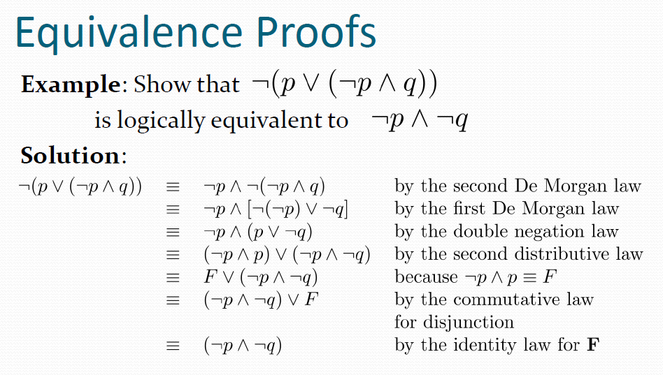

Slide 35
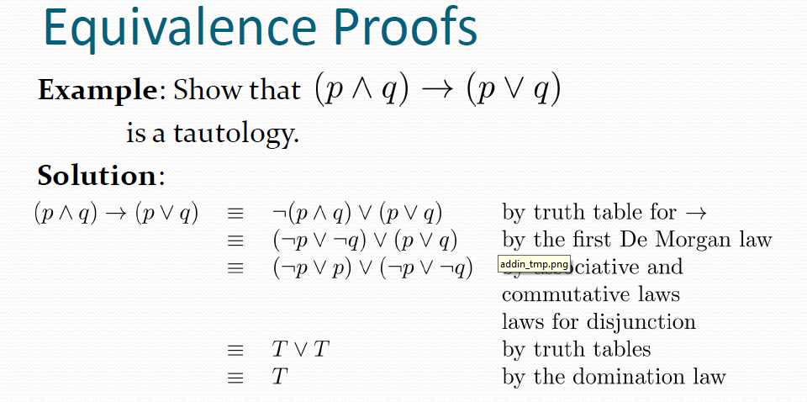

Slide 36
Propositional Satisfiability
A compound proposition is satisfiable if there is an assignment of truth values to its variables that make it true. When no such assignments exist, the compound proposition is unsatisfiable.
A compound proposition is unsatisfiable if and only if its negation is a tautology.

Slide 37
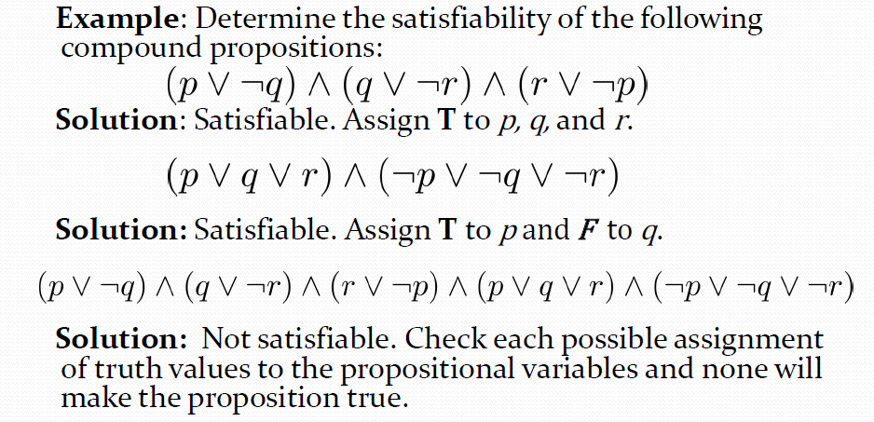
Questions on Propositional

